Slide 1


Introduction To
Data Science
Simple Linear Regression
“Hiding within those mounds of data is the knowledge that could change the life of a patient, or change the world”

Slide 2
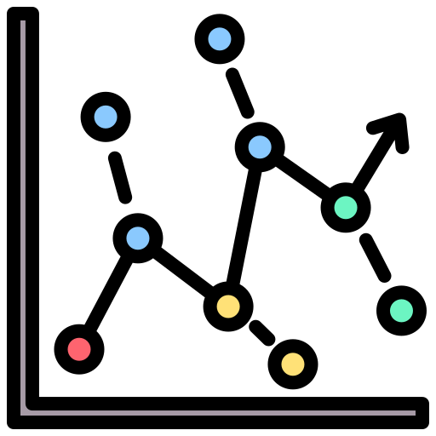
Simple Linear Regression
Simple Linear Regression
Predict / explain the values of a quantitative variable Y from another variable X

Slide 3
Modèle de Régression linéaire simple
Simple Linear Regression

Slide 4
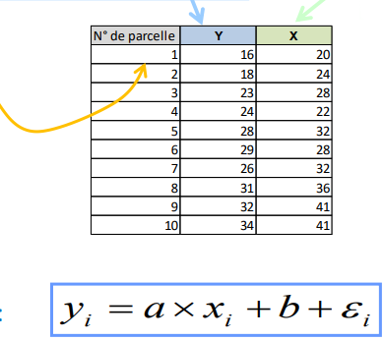
Position of the problem
Simple Linear Regression
Simple regression example, Explain corn yield Y (in quintals) from the amount of fertilizer used (in kilograms) on similar plots of land.
Variable to be predicted
Class attribute
Endogenous variable Quantitative
Predictive variables
Descriptor
Exogenous variable
Quantitative or binary
Identifier
(Not used for calculations, but can be used for be used for comments : Atypical points, etc.)
Simple regression model:
We therefore have a sample of n pairs of points (xi, yi) i.i.d. (independent and identically distributed), and we want to explain (predict) the values of Y according to the values taken by X.
The random term allows us to summarize all the information that is not taken into account in the linear relationship between Y and X (specification problems, approximation of linearity, summarizing the variables that are absent, etc.). variables that are absent, etc.).

Slide 5
Hypotheses
Simple Linear Regression
To determine the properties of estimators And to set up inferential statistics tools (hypothesis tests, confidence intervals)
H1: Assumptions on X and Y. These are numerical quantities measured without error. X is a data (exogenous) in the model, Y is random through ᶓ (i.e., the only error we have on Y comes from the insufficiencies of X to explain its values in the model).
H2: Assumptions on the random term. The ᶓ i's are i.i.d. (independent and identically distributed)
(H2.a) On average the errors cancel out, the model is well specified
(H2.b) The variance of the error is constant and does not depend on the observation: homoscedasticity
(H2.c) In particular, the error is independent of the exogenous variable
(H2.d) Independence of the errors, the errors relative to 2 observations are independent (we also say that the errors "are not correlated")
(H2.e) Normal law

Slide 6
Hypotheses
Simple Linear Regression
To determine the properties of estimators And to set up inferential statistics tools (hypothesis tests, confidence intervals)
H1: Assumptions on X and Y. These are numerical quantities measured without error. X is a data (exogenous) in the model, Y is random through ᶓ (i.e., the only error we have on Y comes from the insufficiencies of X to explain its values in the model).
H2: Assumptions on the random term. The ᶓ i's are i.i.d. (independent and identically distributed)
(H2.a) On average the errors cancel out, the model is well specified
(H2.b) The variance of the error is constant and does not depend on the observation: homoscedasticity
(H2.c) In particular, the error is independent of the exogenous variable
(H2.d) Independence of the errors, the errors relative to 2 observations are independent (we also say that the errors "are not correlated")
(H2.e) Normal law

Slide 7
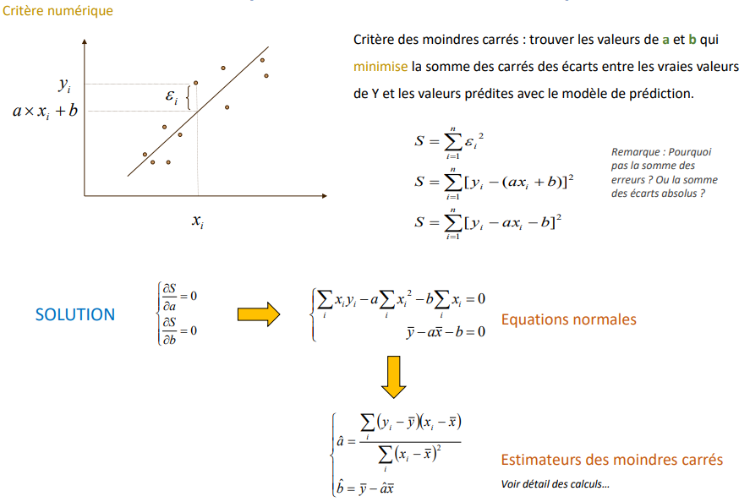
OLS (ordinary least squares) estimator
Simple Linear Regression
Numerical criteria
Least squares criterion: find the values of a and b that
minimizes the sum of squares of the differences between the true values of Y and the values predicted with the prediction model.
Remark:
Why not the sum of the errors?
Or the sum of absolute deviations?
Normal equation
ordinary least squares

Slide 8
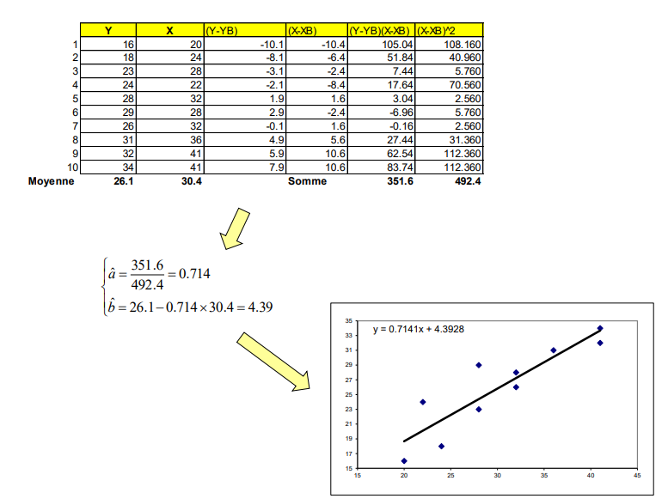
Example of agricultural yields
Simple Linear Regression
Mean
Sum

Slide 9
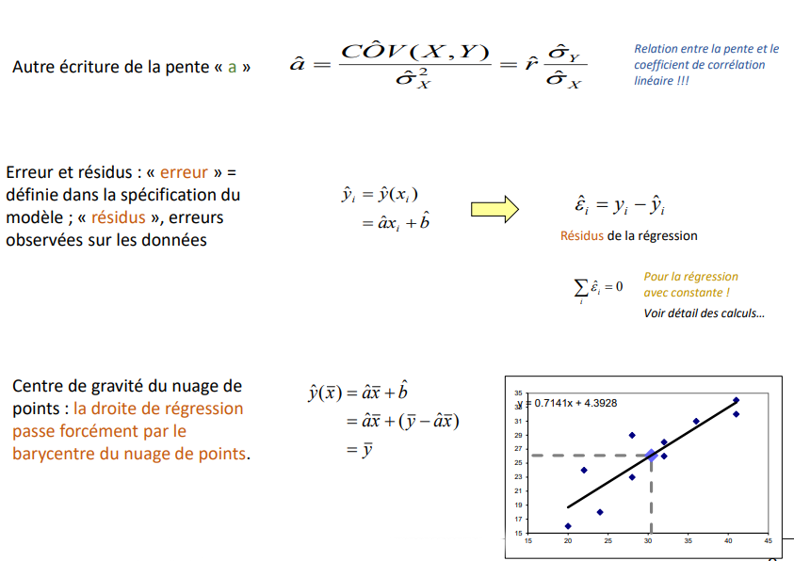
Some comments
Simple Linear Regression
Relationship between the slope and the correlation coefficient linear!!!
Other writing of the slope "a”
Error and residuals: "error" = defined in the specification of the model; "residuals" are errors observed on the data
Regression residuals
For the regression with constant !
See details of the calculations...
Center of gravity of the cloud of points points : the regression line necessarily passes through the barycenter of the point cloud

Slide 10
Evaluation: Analysis of variance and coefficient of determination
Simple Linear Regression

Slide 11
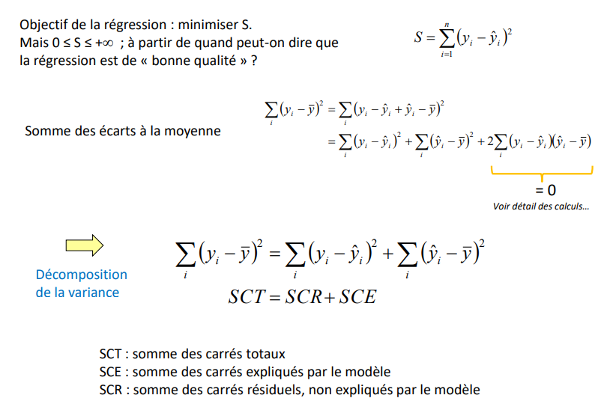
Analysis of variance equation Variance decomposition
Simple Linear Regression
Objective of the regression: minimize S. But 0 ≤ S ≤ +inf; at what point can we say that the regression is of "good quality"?
Sum of deviations from the mean
See details of calculations
Decomposition of the variance
TSS: sum of total squares
SCE: sum of squares explained by the model
SCR : sum of residual squares, not explained by the model

Slide 12
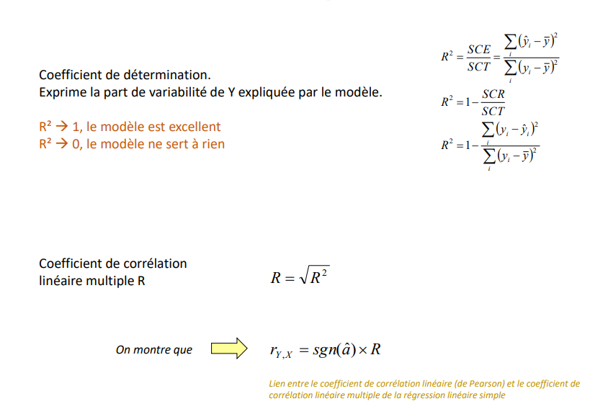
Coefficient of determination And coefficient of multiple linear correlation
Simple Linear Regression
Coefficient of determination.
Expresses the share of variability of Y explained by the model.
R² → 1, the model is excellent
R² → 0, the model is useless
Correlation coefficient
multiple linear R
We show that
Relationship between the linear correlation coefficient (Pearson) and the multiple linear correlation coefficient multiple linear correlation coefficient of the simple linear regression

Slide 13
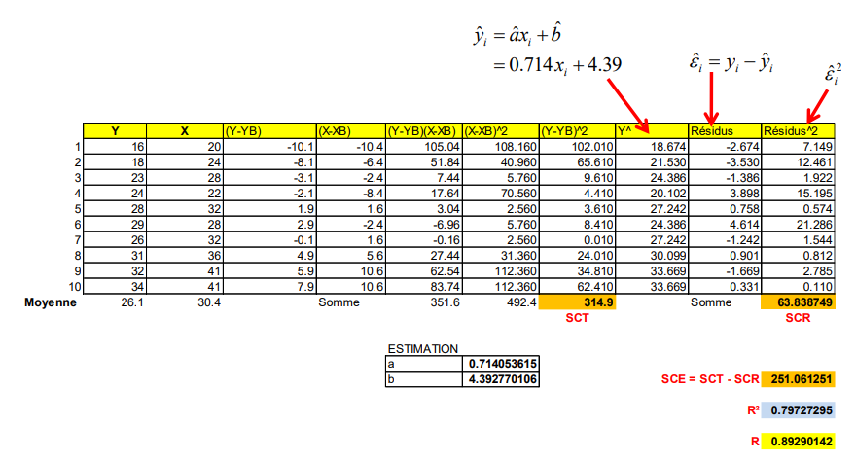
Example of agricultural yields
Simple Linear Regression
Mean

Slide 14
Evaluation: Properties of estimators
Simple Linear Regression

Slide 15
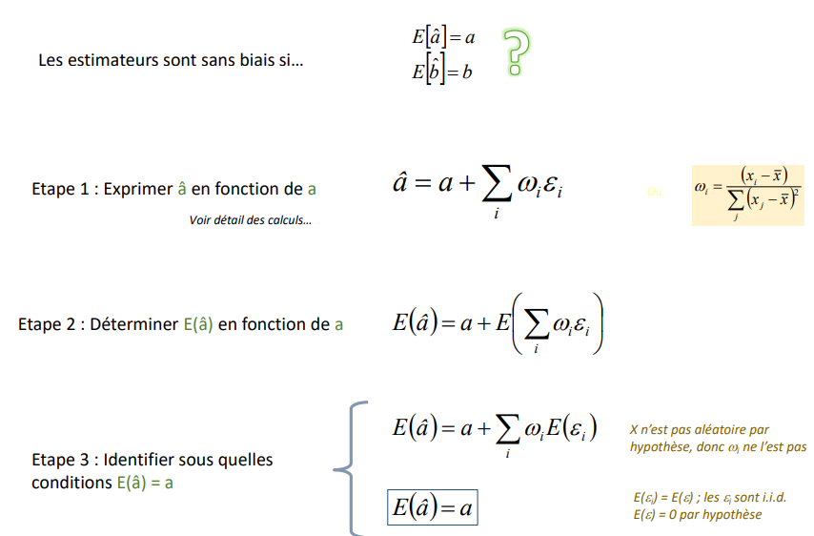
Bias
Simple Linear Regression
The estimators are unbiased if...
Step 1: Express â as a function of a
Step 2: Determine E(â) as a function of a
X is not random by hypothesis so ωi is not random
Step 3: Identify under which conditions E(â) = a
E(Ɛi) = E(Ɛ); the Ɛi are i.i.d.
E(Ɛ) = 0 by hypothesis

Slide 16
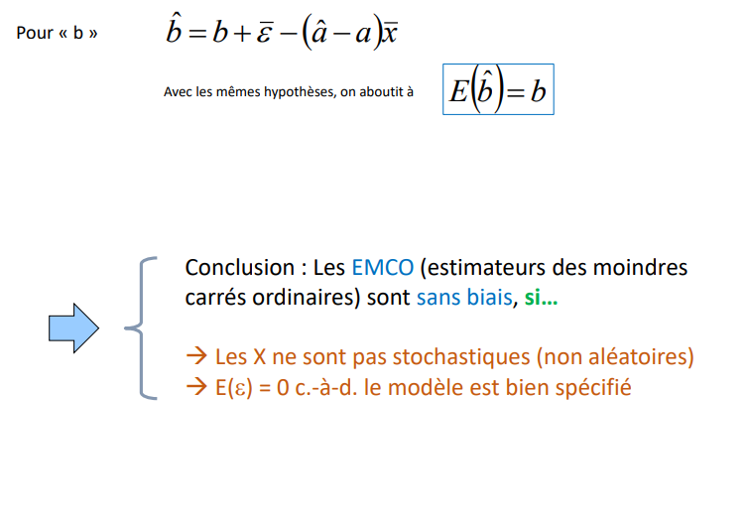
Bias
Simple Linear Regression
For “b”
With the same assumptions, we end up with
Conclusion : The OLS (ordinary least squares estimators) are unbiased, if squares) are unbiased, if...
→ Xs are not stochastic (non-random)
→ E(Ɛ) = 0 i.e., the model is well specified

Slide 17
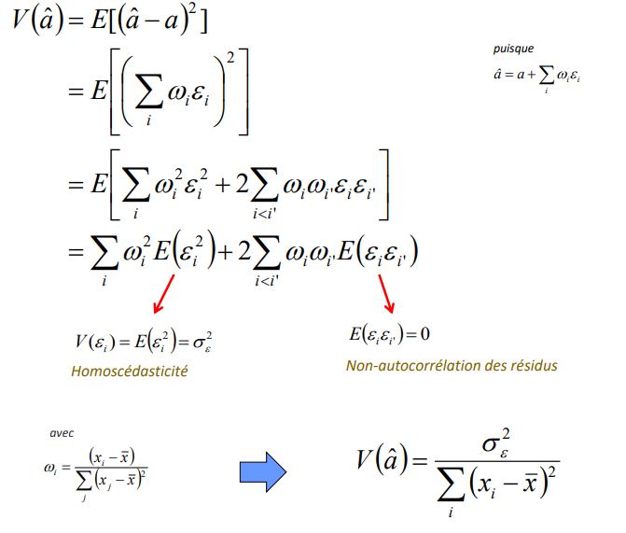
Bias
Simple Linear Regression
Since
Homoscedasticity
Non-autocorrelation of residues
With

Slide 18
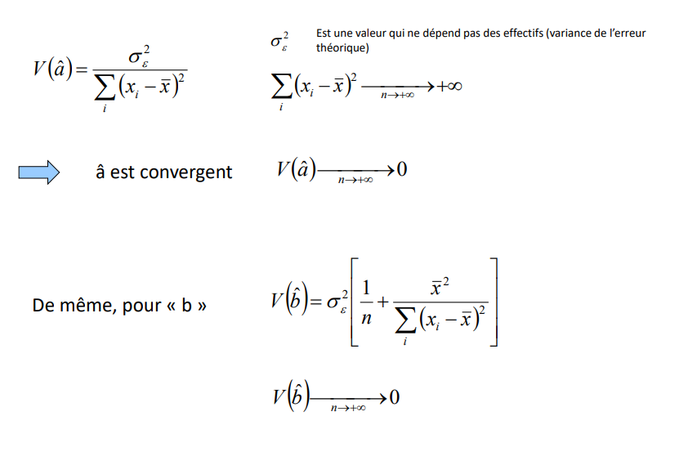
Convergence
Simple Linear Regression
Is a value that does not depend on the number of people (variance of the error)
â is convergent
Similarly, for "b"

Slide 19
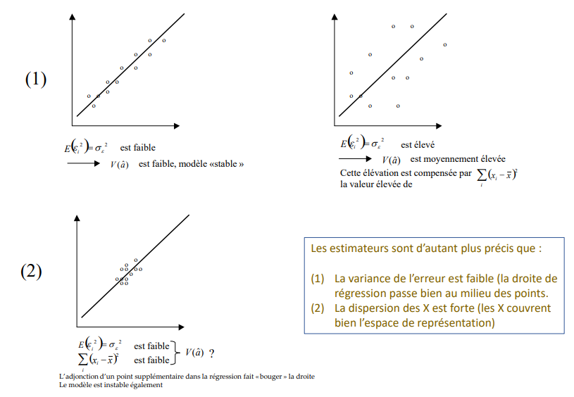
Graphic characterization
Simple Linear Regression
is low
V (aˆ) is small, "stable" model
Is High
V(â) is moderately high
This increase is compensated by
the high value of
Estimators are more accurate when:
(1) The variance of the error is small (the regression line (the regression line passes well in the middle of the points.
(2) The dispersion of the X's is strong (the X's cover the representation the representation space)
Is low
Is low
The addition of an extra point in the regression makes the line "move The model is also unstable

Slide 20
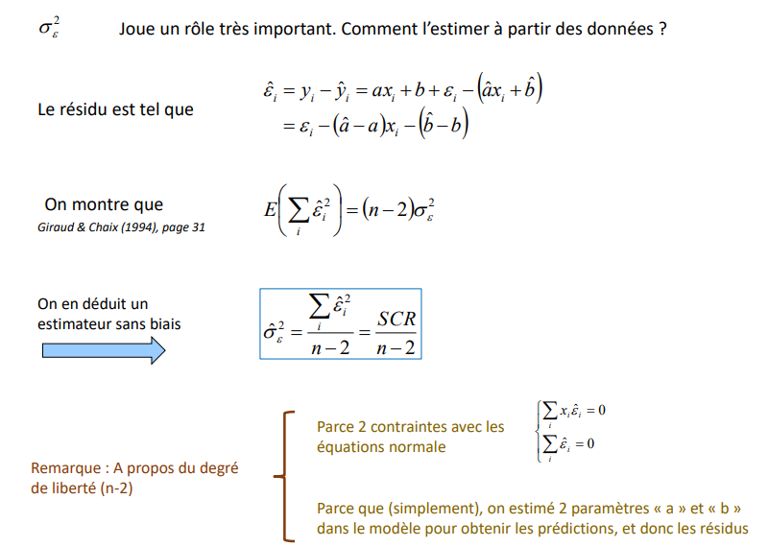
Estimation of the variance of the error
Simple Linear Regression
Plays a very important role. How to estimate it from the data?
The residue is such that
We show that
We derive an
unbiased estimator
Because 2 constraints with the normal equations
Remark : About the degree
of freedom (n-2)
Because (simply), we estimate 2 parameters " a " and " b " in the model to obtain the predictions, and thus the residuals.
in the model to obtain the predictions, and thus the residuals

Slide 21
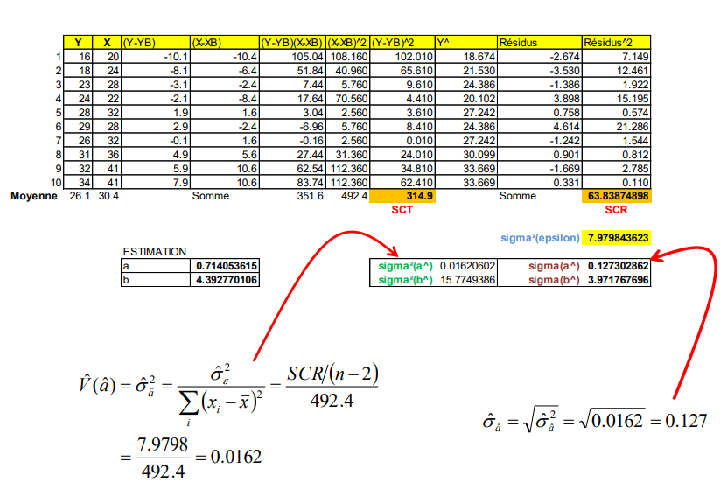
Agricultural yields
Simple Linear Regression
Mean
Sum
Sum

Slide 22
Distribution of estimated coefficients - Statistical inference
Simple Linear Regression

Slide 23
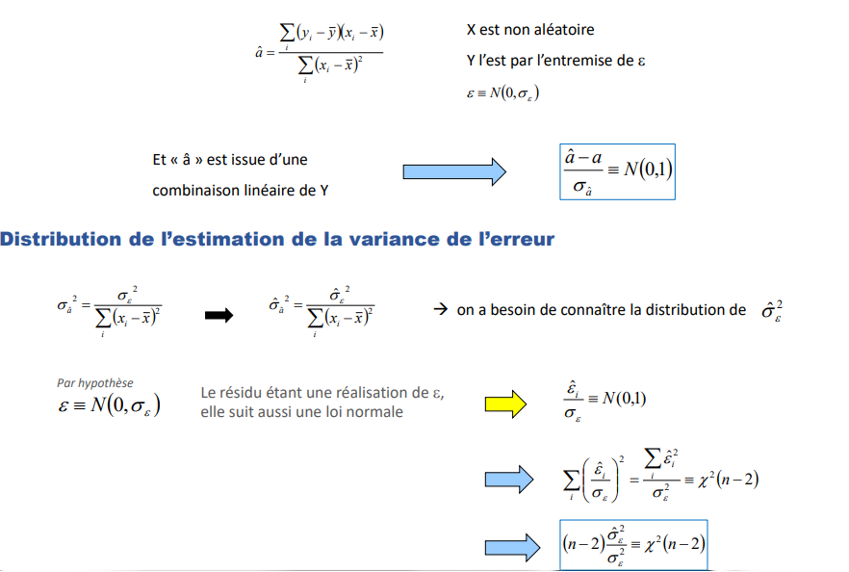
Distribution of "â" - Variance of the known error
Simple Linear Regression
X is non-random
Y is random through Ɛ
And "â" is the result of a
linear combination of Y
Distribution of the estimate of the variance of the error
we need to know the distribution of
By hypothesis
The residual being a realization of Ɛ,
it also follows a normal distribution

Slide 24
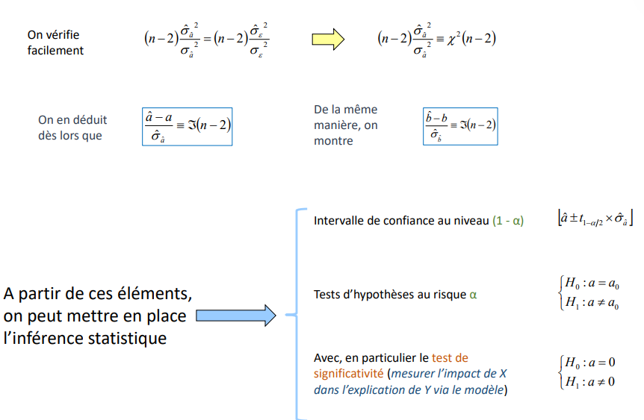
The residual being a realization of , it also follows a normal distribution
Simple Linear Regression
It is easy to check
We deduce that that
In the same way, we show
Confidence interval at the (1 - α) level
From these elements, we can set up statistical inference
Hypothesis testing at risk α
With, in particular, the test of significance (measuring the impact of X in the explanation of Y via the model)

Slide 25
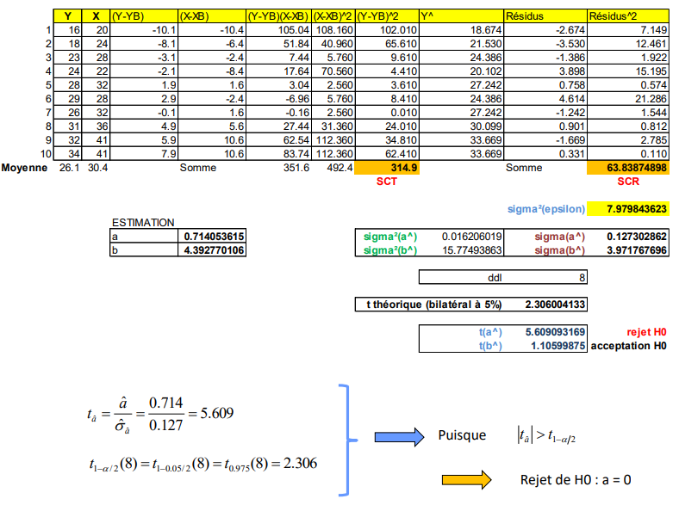
Agricultural yields - Tests of significance of coefficients
Simple Linear Regression
Mean
Sum
Sum
Rejection of H0
Acceptance of H0
Since
Rejection of

Slide 26
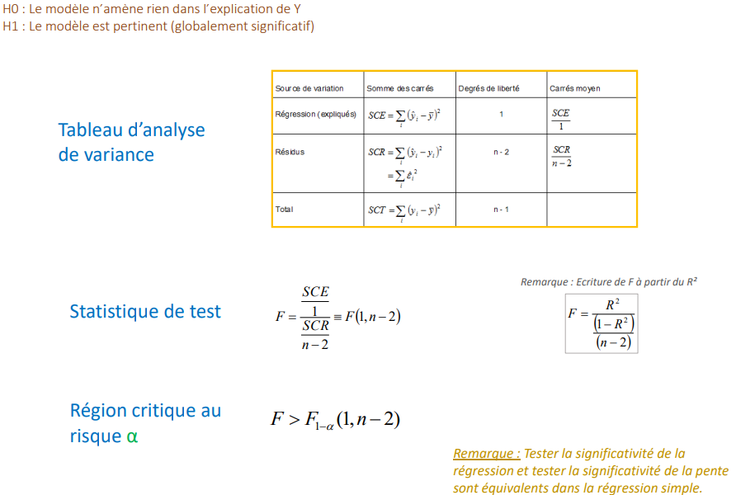
Global significance test of the model
Simple Linear Regression
Rejection of
H0 : The model does not bring anything in the explanation of Y
H1: The model is relevant (globally significant)
Variation Source
Sum of the squares
Degree of freedom
Mean square
Analysis of variance of variance
Regression Explained
Residues
Total
Rejection of
Test statistics
Critical region at risk α
Note: Testing the significance of the regression and testing the significance of the slope are equivalent in the simple regression

Slide 27
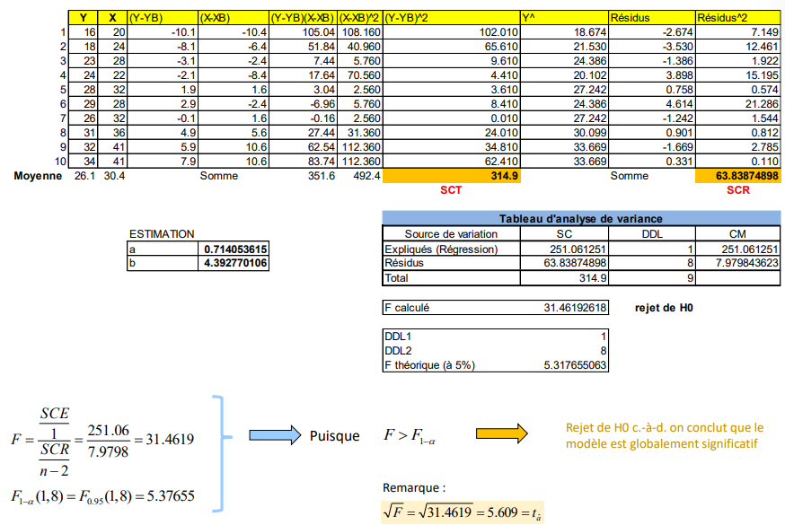
Agricultural yields - Overall significance tests
Simple Linear Regression
Mean
Sum
Sum
Source of variation
Explained (Regression)
Residue
Total
Calculated F
Rejection of H0
Theoretical F
Since
Rejection of H0 i.e., we conclude that the model is globally significant

Slide 28
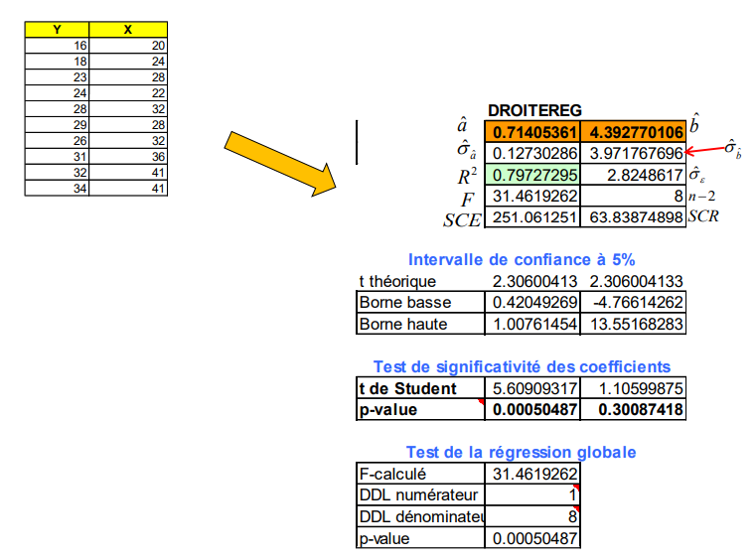
Agricultural yields - Overall significance tests
Simple Linear Regression

Slide 29
Forecast and forecast interval
Simple Linear Regression

Slide 30
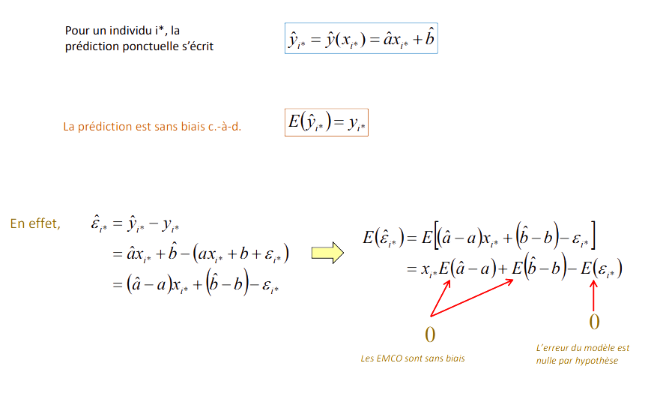
Point prediction From a known value of X, predict the value of Y
Simple Linear Regression
For an individual i*, the
point prediction is written as y
The prediction is unbiased i.e.
Indeed,
EMCOs are unbiased
The error of the model is null by hypothesis

Slide 31
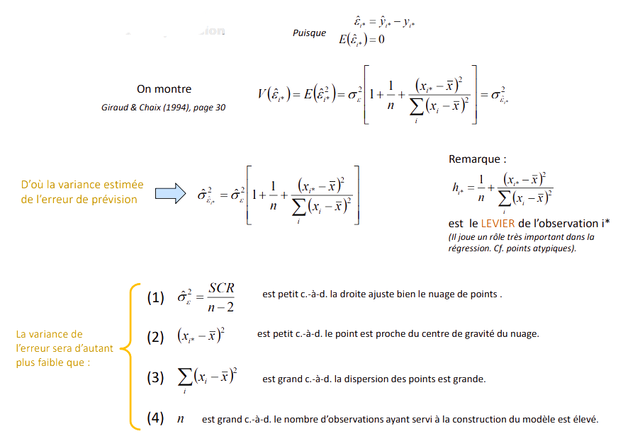
Interval forecasting Variance of the forecast error
Simple Linear Regression
Since
We Show
We Show
Hence the estimated variance
of the forecast error
is the LEVER of the observation i*
(It plays a very important role in the
regression. Cf. atypical points).
is small, i.e. the line fits the scatter plot well.
The variance of the error will be lower the more :
is small i.e. the point is close to the center of gravity of the cloud.
is large, i.e. the dispersion of the points is large.
is large, i.e. the number of observations used to build the model is high.

Slide 32
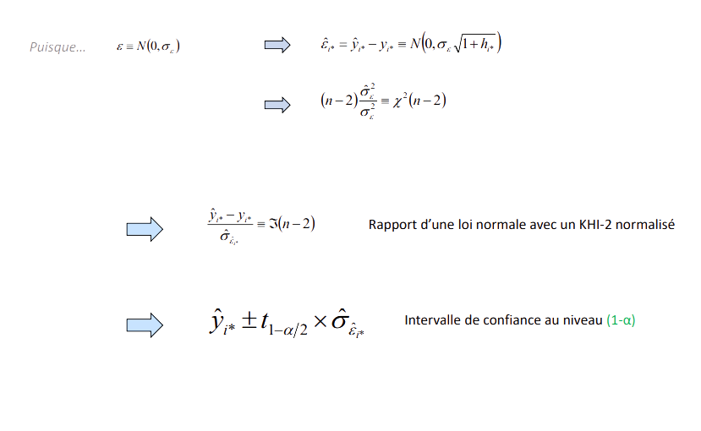
Interval forecasting Distribution - Interval Definition
Simple Linear Regression
Since
Ratio of a normal distribution with a normalized KHI-2
Confidence interval at the (1-α) level

Slide 33
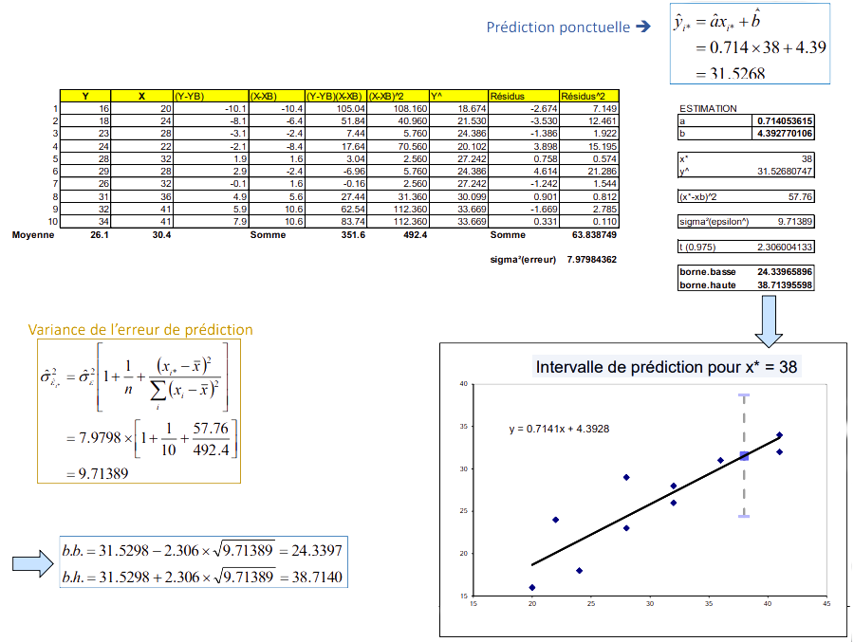
Agricultural yields - x* = 38
Simple Linear Regression
Punctual Prediction
Mean
Sum
Prediction Error Variance
Prediction Interval for x* = 38

Slide 34
Derived models and interpretation of coefficients
Simple Linear Regression

Slide 35
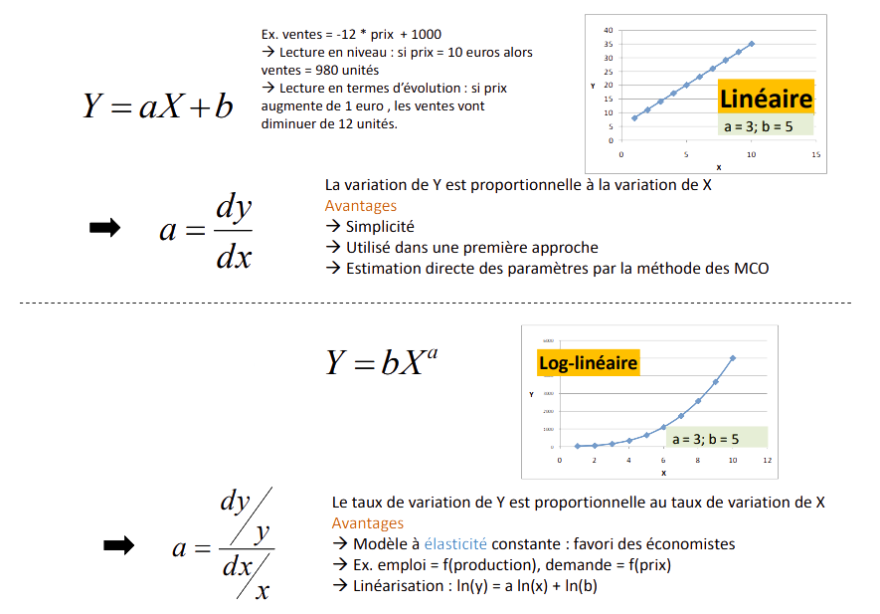
Linear model Slope reading
Simple Linear Regression
Ex. sales = -12 * price + 1000
→ Reading in level: if price = 10 euros then sales = 980 units
→ Reading in terms of evolution: if price increases by 1 euro, sales will decrease by 12 units.
Linear
The variation of Y is proportional to the variation of X Advantages
→ Simplicity
→ Used in a first approach
→ Direct estimation of the parameters by the OLS method
Log-Linear
Log-linear model
The rate of change of Y is proportional to the rate of change of X Advantages
→ Constant elasticity model: favourite of economists
→ Ex. employment = f(output), demand = f(price)
→ Linearization: ln(y) = a ln(x) + ln(b)

Slide 36
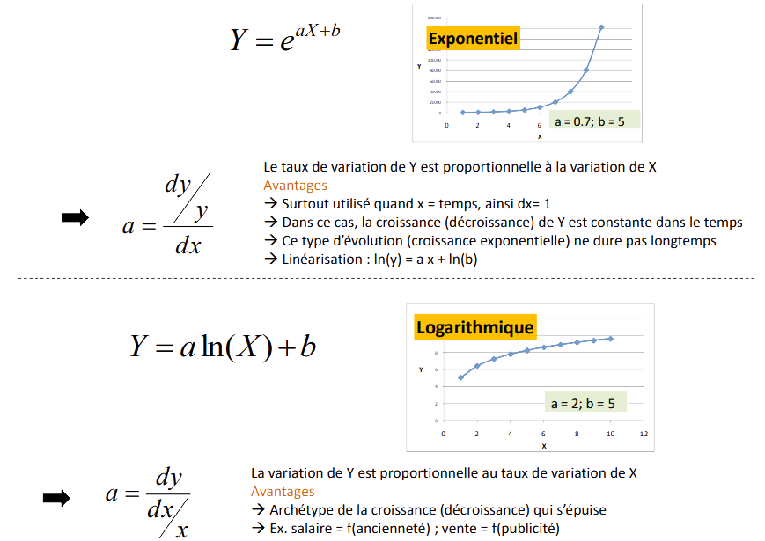
Exponential model (geometrical)
Simple Linear Regression
Exponential
The rate of change of Y is proportional to the change of X Advantages
→ Mostly used when x = time, so dx= 1
→ In this case, the growth (decrease) of Y is constant in time
→ This type of evolution (exponential growth) does not last long
→ Linearization : ln(y) = a x + ln(b)
Logarithmic
Logarithmic model
The change in Y is proportional to the rate of change in X
Advantages
→ Archetype of growth (decay) that runs out
→ Ex. salary = f(seniority); sales = f(advertising)

Slide 37
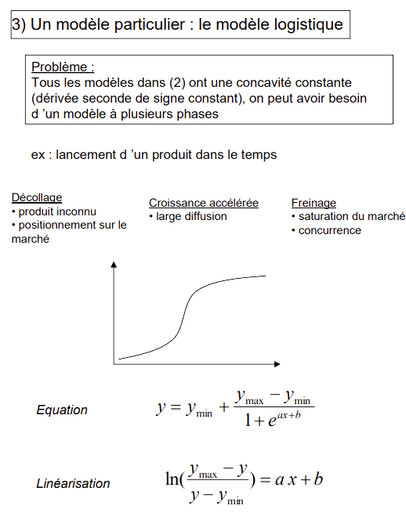
Interval forecasting Distribution - Interval Definition
Simple Linear Regression
3) A particular model: the logistic model
Problem:
All models in (2) have constant concavity (second derivative of constant sign), one may need a multiphase model
e.g. : launch of a product in time
Take off
- unknown product
- positioning on the market
Accelerated growth
- wide distribution
Braking
- market saturation
- competition
Equation
Linearization

Slide 38
Regression without constant
Simple Linear Regression

Slide 39
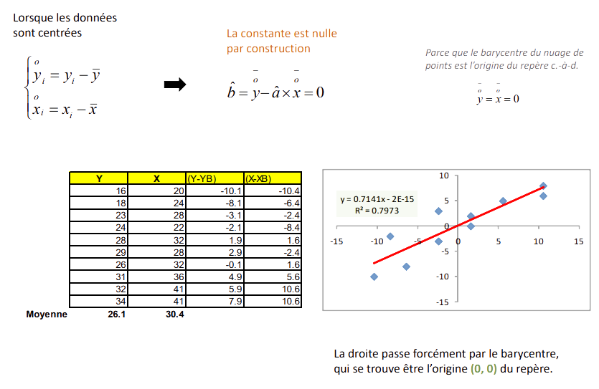
Case of centred data
Simple Linear Regression
When the data are centred
The constant is zero by construction
Because the barycentre of the cloud of is the origin of the reference frame, i.e.
Mean
The line necessarily passes through the barycentre, which is the origin (0, 0) of the reference frame.

Slide 40
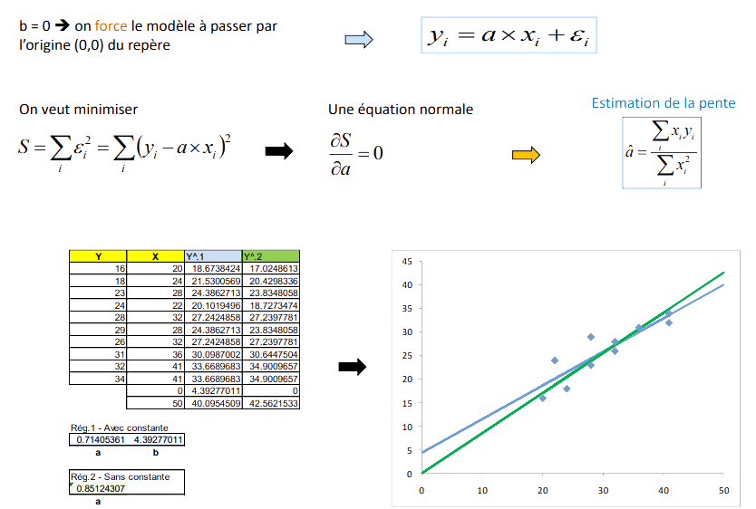
Case of centred data
Simple Linear Regression
b = 0 ➔ we force the model to pass through
the origin (0,0) of the reference frame
A normal Equation
Slope Estimation
We want to minimize
Rule1
With Constant
Rule2
Without Constant

Slide 41
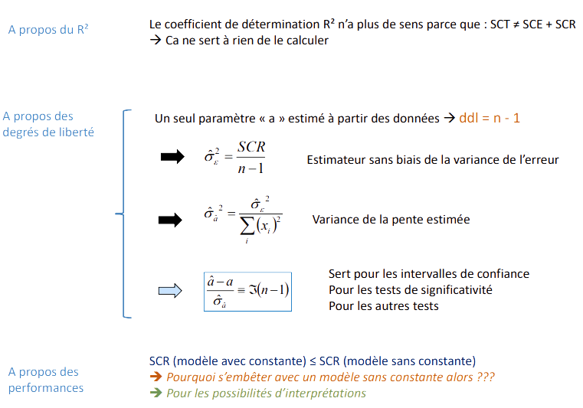
Case of centred data
Simple Linear Regression
About the R²
The coefficient of determination R² is no longer meaningful because: SCT ≠ SCE + SCR → It is useless to calculate it
About the
degrees of freedom
A single parameter "a" estimated from the data → ddl = n - 1
Unbiased estimator of the variance of the error
Variance of the estimated slope
Used for confidence intervals
For significance tests
For other tests
About the
performance
SCR (model with constant) ≤ SCR (model without constant)
➔ Why bother with a model without constant then???
➔ For the possibilities of interpretations

Slide 42
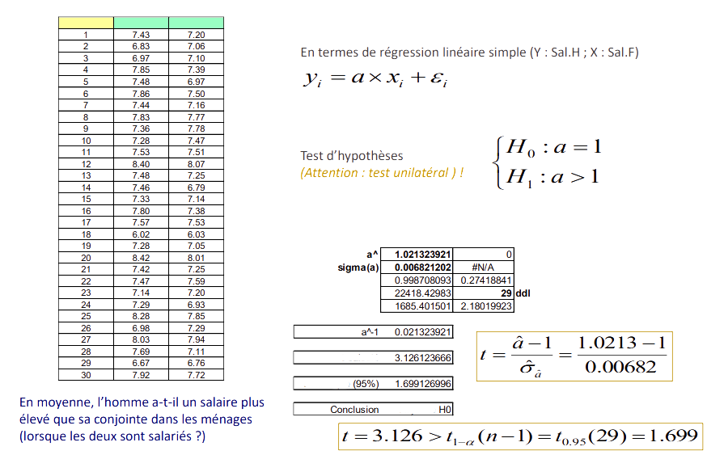
Case of centred data – Example Comparison of wages within households
Simple Linear Regression
Number
Salary Men
Salary Women
In terms of simple linear regression (Y: Sal.H; X: Sal.F)
Hypothesis test
(Attention: one-sided test) !
t calculated
t-theoretical
On average, does the man earn more than his than his spouse in households (when both are employed?)
Rejection of

